Slide 1
Ocean of things
Iot engineering
The information in this document is proprietary to Iridium Satellite LLC. It may not be used, reproduced, or disclosed without written approval from Iridium Satellite LLC.

Slide 2
Intro
Not much information on the program and specifics of how its intended to work
high level introduction on items that are likely important to this sort of application project based on the information available
Latency
Throughput
Success Rate
Battery Power/Consumption
Hardware design
Certification
Understand that engineering changes may be needed for phase 2 so even though some of these items have been completed it’s still relevant
Going forward detailed discussions can continue via email.

Slide 3
Available Resources
Data Support provide general customer service to all partners and:
Log & track general issues
Provide updates relating to service/network status
Answer SPNet/provisioning/device usage related questions
Iridium’s IoT Applications Team provide engineering and white glove support to existing and new partners via:
Engineering support for hardware/software development and integration
Training on IoT products and services (9602/9603/9523/SBD/RUDICS)
Certification guidance
IFP (must be a partner)
The latest documents, tech notes and firmware are posted to IFP on a regular basis
https://www.iridium.com/ifp/

Slide 4
Iot and SBD

Slide 5
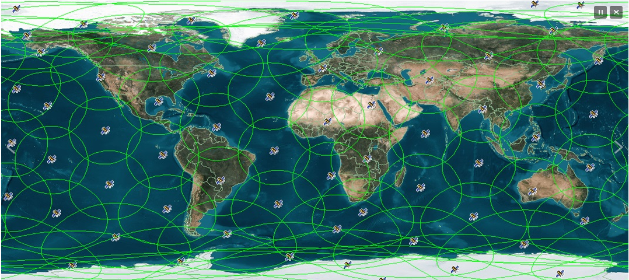
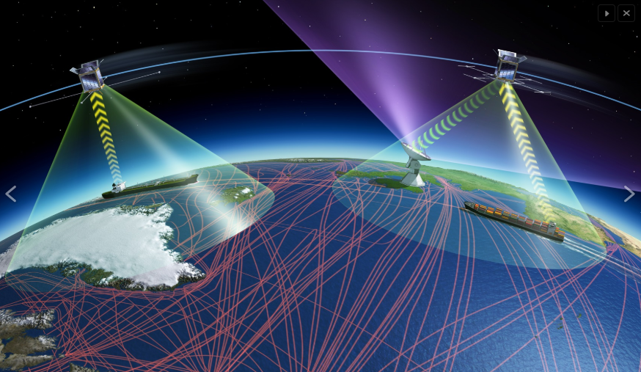
the iridium network
Iridium’s network of low earth orbit satellites with satellite crosslinks is ideally suited for the needs of existing and emerging markets
Iridium’s low earth orbit
Allows for small omni-directional antennas
Require no mechanical re-positioning
Both handheld and fixed mast products are available
Iridium’s crosslinks
100% pole-to-pole coverage
Bent-pipe LEO systems offer no coverage beyond the view of their earth stations
Iridium’s near polar orbit ensures complete coverage inside the arctic/ antarctic circles benefiting fishing, shipping, naval and research vessels

Slide 6
Sbd: Short Burst Data
SBD is a simple, easy to use and efficient packet-based service for two way short data transmissions
SBD is a true global solution that has
Low latency (<20 seconds end to end under good operating conditions).
Low power consumption (short transactions & low idle current – 35mA).
High success rate (>95% for all certified products).
Messages sent from the SBD modem (MO-SBD) can be delivered to email, IP, or another Iridium transceiver.
Messages sent to the SBD modem (MT-SBD) will be held at the gateway until the field application is ready to receive the data.
Process to send & receive messages is easy
AT+CSQ – check signal quality
AT+ SBDWT – write message to modem buffer
AT+SBDIX – upload and download SBD messages
AT+SBDRT – read downloaded message

Slide 7

Iot traffic map
Average approx. 6.5 Million SBD Sessions daily

Slide 8
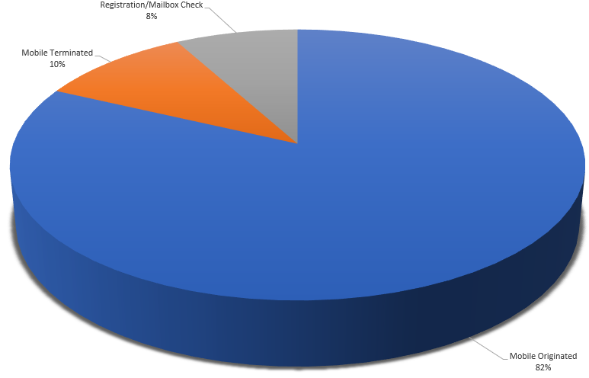
Types of SBD Calls
Mobile Originated – from remote device to customer server
Mobile Terminated - from customer server to remote device
Registration/Mailbox Check – check if MT-SBD is waiting

Slide 9
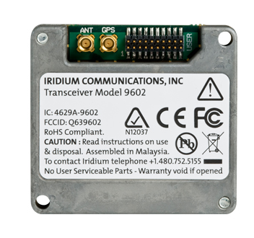
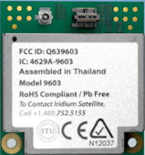
sbd Transceivers
Iridium’s 9602 and 9603 have Board-to-Board form factors with typical applications in personnel and asset tracking, fleet management, environment and safety monitoring, remote automation and control.
Average current consumption is ~35mA at idle and ~140mA during Tx
MO = 340 bytes, MT = 270 bytes
Operating Temperature Range = -40ºC to +85ºC
9602 has GPS pass-through (9603 doesn’t)
Allows Iridium & GPS to share a single antenna
41 x 45.04 x 13mm
31.5 x 29.6 x 8.1mm

Slide 10
Antennas and certification

Slide 11
Iridium Certification
Certification validates that an Iridium partner solution performs at an acceptable level over the Iridium network
Certification does not certify or otherwise make any representation or warranty as to the quality, effectiveness, reliability, performance or safety of the certified product
In other words, a certification pass means we’ve tested your hardware to ensure it provides good quality performance and does no harm to our satellite network in terms of excessive power consumption
Test requirements vary depending on the modem used and your design
It is important to engage Iridium early in the process to ensure correct design and testability for certification
You can review the process & submit products for certification on our website https://www.iridium.com/ifp/certification/
We will follow up with instructions/next steps after reviewing your submission

Slide 12
Iridium Certification process
All products that intend to use the Iridium network must undergo certification
Iridium Certification is applicable to all products - 9602(N), 9603(N), 9523(N) and 9522B modules
Antenna
If your product uses an antenna that is not Iridium certified, or your antenna is embedded within a plastic housing Iridium will conduct KPI testing in Tempe, AZ
9523(N)
9523 based products are always DVT tested at Iridium HQ (design verification)
Automatic Certification
9602(N), 9603(N), 9522B based products qualify for automatic certification if
There are no active components between the ISU & antenna, AND
You are using an external Iridium certified antenna
Certification is free of charge
Turnaround ~2 weeks for antennas ~4 weeks for DVT
Iridium may request additional testing based on submitted information

Slide 13
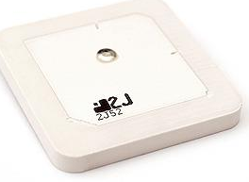
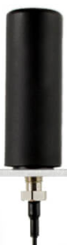

Antenna selection
Antenna selection is very important
Helical
Recommended unless there are size/space restrictions
Generally provides better link margin (v imp. if doing voice/data calls)
Better at lower elevation angles
Patch
Through hole mounted
Compact design
Select highest gain option
Higher risk
Patch
Helical
At 0 degrees latitude, the satellite will be
above 22° elevation about 50% of the time
22°
22°
below 22 degrees elevation 50% of the time

Slide 14
Patch antenna Certification
Helical antennas generally outperform patch counterparts due superior beam pattern that is better matched to the Iridium SV and look angles
Relatively easy to design for
Certification usually not be a problem
For patch antennas it’s especially important to engage Iridium early
Complete the form on IFP before finalizing your design and plastics
The applications & certification team can asses your design and provide feedback in as much detail as necessary
Partners engaging us have seen significant improvements in device performance
Patch antenna selection
Gain is directly proportional to aperture i.e. go with the largest antenna you can
35x35 or 40x40mm patches generally work well
Always follow the manufacturers recommended placement
ground size
Steer clear of combined Iridium & GPS patch antennas if possible
Hard to tune properly for either band
Either Iridium or GPS side end up suffering
If Iridium fails > certification is difficult
If GPS suffers > acquisition can take more time/more energy

Slide 15
Patch antenna Certification
Many patch antennas perform fine on the application board but see significant changes in performance once embedded into a product
If using separate Iridium and GPS antennas
Mount them as far apart as possible
During design consider the following design & layout guidelines
Antenna placement should ensure adequate clearance from other circuits & components.
Check with the antenna manufacturers for the recommended size and pattern of the antenna ground.
Avoid near field interactions (no nearby metals).
Place the radiating side of the antenna as far away from the plastic enclosure as possible.
Always verify antenna performance once assembled into the final product
Leave space for a matching network (e.g. PI network) in case it is needed later.

Slide 16
Latency, throughput, power consumption, success rates

Slide 17
battery/power consumption
Iridium L-band communication takes place within the structure of a frame
Each frame is 90ms
4 uplink and 4 downlink slots
Each slot is 8.28ms separated by guard bands
Only one uplink/downlink combination used per frame
When the modem first powers up
Consumes a higher average current
Moves through the various states (Ring search/scan/monitor/acquisition…)
For best battery performance may not always be best to power down between sessions
Current use depends on the constellation view & signal quality
As signal quality degrades, the devices spends a greater amount of time looking for and maintaining the ring channel
Idle current depends on the state of the modem.
Poor connection will result in a greater number of dropped frames and retransmits

Slide 18
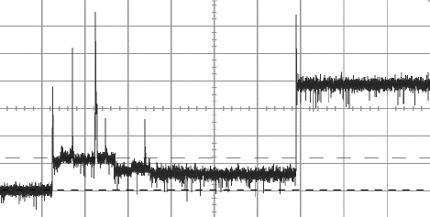
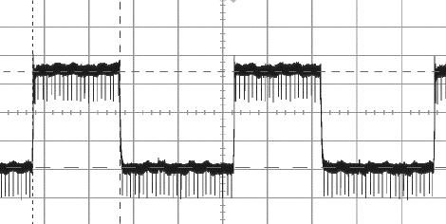
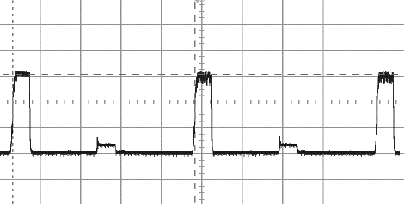
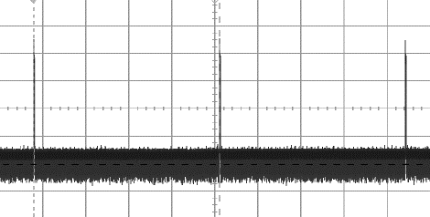
battery/power consumption
Power on & Ring Search
Ring Scan
SBD Transfer Tx/Rx
Ring Monitor
Ring Search – Acquire network (no current knowledge)
Ring Scan – Evaluate most appropriate single beam to monitor (active 48 frames)
Ring Monitor – Low power state receiving ring channel from single beam (active 1/48 frames)
SBD Transfer – One uplink slot (8.2ms) followed by downlink (8.2ms) each 90ms frame
*in between states not shown

Slide 19
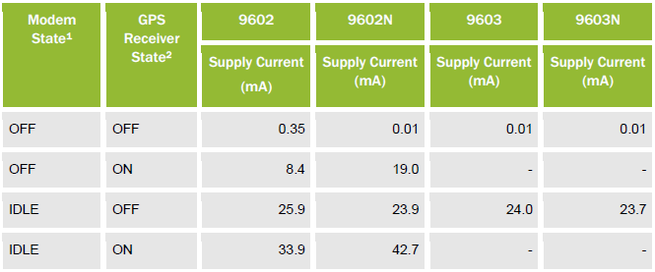
battery/power consumption
Good signal quality usually reduces power consumption
Relaxed idle & fewer transmission retries
Signal strength ultimately dependent on engineering quality, antenna selection and view of constellation
Ensure CSQ > 3 before initiating SBD transfer
Peak current draw ~2A during SBD session
Average idle current spec is ~35mA, may be higher/lower in practice
Lab measured data with 5V supply

Slide 20
start up & send
Start up time typically <1 second after power is applied
You may use the DSR signal as an indication that the 9602/9602N/9603/9603N is powered up and ready i.e. DSR indicates readiness to accept communication over the data port.
Make sure the communication signals are not active before the device is switched on, this can cause the modem to enter a non-functional latched up state. All 3.3V digital inputs should be left floating or grounded.
Ensure CSQ > 3 before initiating SBD session
Between switching off the device and turning it back on, wait 2 seconds
Otherwise the modem can be placed into a non-operational state
Not permanent
Make sure the device is not conducting any SBD sessions while you enter AT commands

Slide 21
Latency
Possible < 10 seconds, typical <20 seconds per 340 bytes
With good antenna, clear view of constellation etc.
Specific timing is difficult to determine due to external factors such as the environment, satellite location/no. of hops, delivery methods etc.
When MO arrives at the gateway, it is passed to either the email or Direct IP servers for delivery
Iridium has no control over email delivery
DirectIP is the preferred option with lower latency and higher reliability
Data channel for SBD is 2.4kbps
340 and 270 bytes for MO and MT SBD
Transmission segments
For MO first segment is 70 bytes, subsequent segments 135 bytes
Modem waits for gateway confirmation before sending the next segment
For MT all segments are 135 bytes

Slide 22
SBD reliability
Overall performance depends on how units are deployed and used
If modems are evenly spread across multiple beams
No problem!
If all modems are spread under one beam
Beam capacity can be reduced
Can become an issue if there are other heavy SBD users in the area
Unlikely where floats will be deployed
To mitigate channel access risks, optimize transmission intervals as much as possible e.g.
Space out transmissions over longer periods of time
E.g. if you have 120 units, 2 transmissions per second is more favorable than 120 at the top of minute
Consider how floats will be synchronized i.e. local clock, GPS or Iridium time
Success rate may suffer if modems become too synchronized and therefore all send messages at once

Slide 23
SBD best practices
When deploying units configured to transmit at regularly scheduled intervals, Iridium strongly advises that transmissions are randomized as much as possible, down to fractions of a minute. This will ensure the health of the network, improve security (Tx not predictable) and ultimately benefit all SBD users. To optimize your transmissions, you should:
Avoid transmitting at the top of the second, minute, hour and day.
Space individual transmissions throughout the minute and ensure messages are evenly distributed over time.
SBD response codes should be used to identify whether a transmission has completed and its status e.g. success/fail. If the SBD session was successful, you may retransmit right away.
If the Iridium modem is in a tracking application with frequent mobile originated messages throughout the day, we recommend 60 seconds between transmissions.

Slide 24
SBD best practices
Before transmitting, check for good signal quality and network availability. If the session fails (e.g. code 32), implement a retry back off scheme starting with 60 seconds. Do not continuously retry.
Be aware that traffic management will activate if you initiate an SBD session multiple times with no success, or little to no signal quality. Under such circumstances, the modem places a timer preventing any further SBD sessions for a specified duration of time – starting with fractions of a second up to a maximum of 10 minutes. See “+SBDLOE” in the AT Command guide for more information and ensure you application is properly configured to manage this.
Removing power will not help as the timer is stored in non-volatile memory
It’s better you manage the back off and have full control over the situation, rather than being forced off the network with no means to take back control
Best practices
Following SBD best practices is highly recommended
Guidelines are test proven to improve success rates
Improves the health of the network benefitting all users

Slide 25
Sbd response codes
Important to monitor and appropriately react to SBD response codes
+SBDIX: <MO status>, <MOMSN>, <MT status>, <MTMSN>, <MT length>, <MT queued>
MO Status
provides an indication of the disposition of the MO transaction
0 – good 2 – ok 18 – RF connection dropped 32 – no network/no signal
2 = messages successfully sent but not able to update geo-location
MOMSN
Mobile Originated Message Sequence Number e.g. 12345
MT Status
provides an indication of the disposition of the MT transaction
0 – no message 1 – SBD successfully received 2 – Error occurred
MTMSN
Mobile Terminated Message Sequence Number
MT Length
Length in bytes of the mobile terminated SBD message received from gateway
MT Queued
Count of mobile terminated messages waiting at the gateway

Slide 26
Ring alerts

Slide 27
MT-SBD & RING ALERTS
MT-SBD messages are not automatically delivered to the unit - RA’s provide a notification that a message is awaiting retrieval at the gateway
Can be thought of as a shoulder tap
Ring Alerts operate using the devices last known location
If the device moves out of the ring alert radius (100 miles) it must be re-attached
AT+SBDAREG for automatic re-attach
The modem must initiate an SBD session in order to retrieve the waiting MT-SBD message queued at the gateway
A mailbox check is an empty SBD session i.e. no payload
Will download waiting messages and return queue size
Used where latency is important and ring alert may be missed (it’s not guaranteed)
A valid MO message will also download MT & return queue information

Slide 28
Ring alert best practices
Ring Alerts can be activated at the gateway (using SPNet) and configured on the modem using +SBDMTA=1. The Iridium transceiver must also register on the network before any Ring Alerts are sent. If the transceiver moves outside the ring alert radius without updating its location (+SBDREG/+SBDAREG), then Ring Alerts will not be received as they’re only transmitted on a single beam based on the transceivers last known location.
If Ring Alerts have been activated at the gateway, the field application must:
1) Always configure +SBDMTA=1.
2) Always update it’s location.
Failure to do so wastes network resources and may result in Iridium Certification failure.
It is good practice to use +SBDIX when initiating any SBD session as this will perform a free registration & location update as part of the transaction.

Slide 29
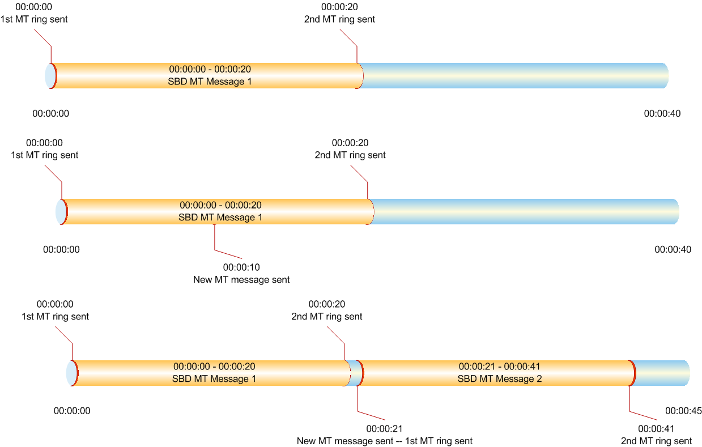
Ring Alert Timing: use cases
1st ring sent when MT is received. 2nd ring sent if no response within 20 seconds.
1st ring sent when MT is received. 2nd MT sent within 20 sec of 1st MT message.
No ring sent for 2nd MT.
1st ring sent when MT is received. 2nd MT sent at 21 sec after 1st MT message.
Ring sent for 2nd MT.

Slide 30
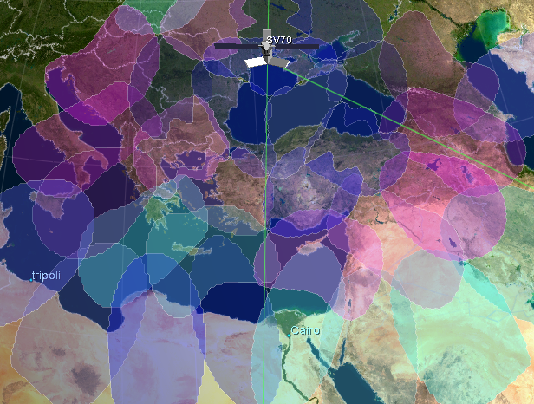
Geo-location accuracy
The Iridium satellites use Doppler signals and angular separation to calculate estimated latitude & longitude
Accuracy can vary from 10’s of KM to hundreds of KM
Cairo would have a hard time resolving geo-location due to satellite being nearly overhead
Tripoli would have more accurate geo-location due to its separation

Slide 31
Spnet, iws and directip

Slide 32
Back office application
SPNet is a convenient web portal that allows Iridium partners to provision and manage Iridium devices
In addition to activation/deactivation, you can set delivery destinations and review call logs
The SPNet website is located at https://spnetpro.iridium.com
Iridium Web Services (IWS)
Allows you to automate provisioning processes by integrating Iridium’s billing and provisioning platforms into your core business operations
IWS is based on Java web services that use Simple Object Access Protocol
Messages sent using SBD are delivered via DirectIP
DirectIP is a socket-based delivery mechanism
The gateway will seek to establish a TCP/IP socket connection to the IP address and port provisioned for the originating IMEI
MO and MT SBD both use a specific message structure (byte stream)
Only the payload is charged
Messages are delivered in a first in first out manner
Email delivery is also available and is often preferred during development
Not as efficient as DirectIP and so not recommended for production use

Slide 33
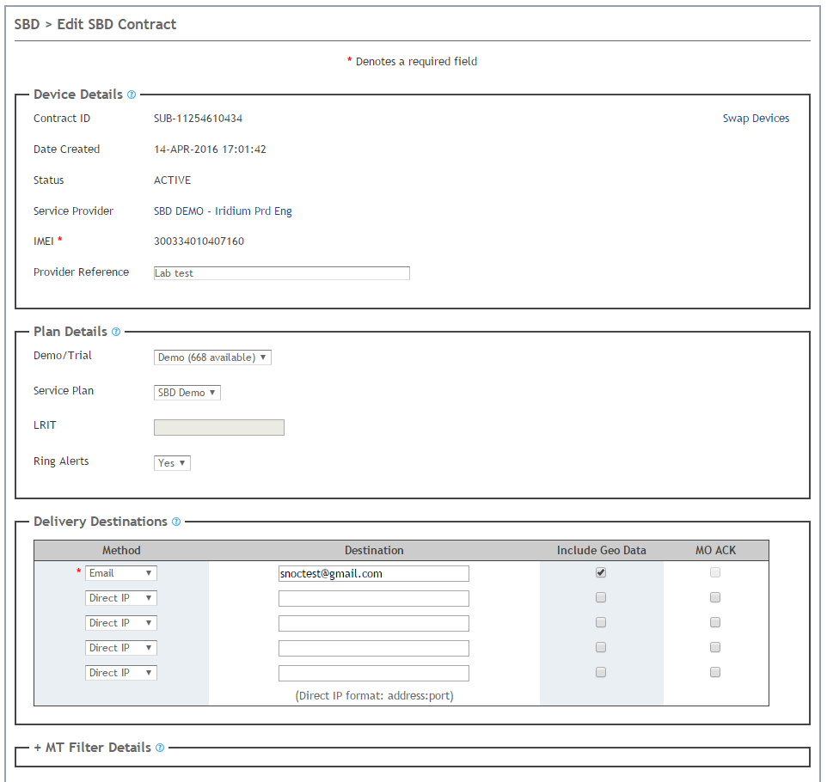
SPNET PROVISIONING SCREENSHOT

Slide 34
MO-SBD DELIVERY DESTINATIONS
Messages can be delivered to:
Up to 5 email addresses (Email delivery)
Up to 5 IP addresses (Direct IP)
Up to 5 other ISU’s (ISU to ISU)
Any combination up to a maximum of 5

Slide 35
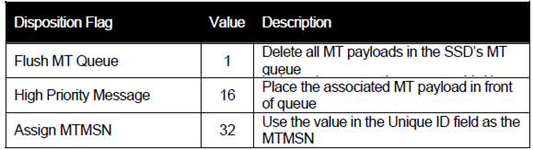
Mt-sbd high priority messages
MT Disposition Flags provide additional functionality offered only via directIP
2-byte field configured via the directIP header
Flush MT Queue
Delete all MT messages queued for an IMEI
Payload will be added after currently queued payloads deleted
High priority designation
Ability to push a message to the front of the queue
Assign MTMSN
16 bit field so values between 1 and 65535

Slide 36
SBD Queue LIMITATIONS
Email Mobile Originated
None
Email Mobile Terminated
Each IMEI allows 50 MT messages to be queued. Messages held 5 days.
If it exceeds 5 days, all MT messages are deleted.
DirectIP Mobile Originated
Each IP address can queue 10,000 messages (FIFO queue)
Email and DirectIP offer retry schemes for undeliverable messages
Email – retry back off mechanism, after 7 days message is purged
DirectIP – retry back off mechanism, after 12 hours message is purged
DirectIP Mobile Terminated
Each IMEI allows 50 MT messages to be queued. Messages held 5 days.
If it exceeds 5 days, all MT messages are deleted.
12 hours to deliver before being archived
Information given is default for commercial gateway, govt. gateway may have other options

Slide 37
Manufacturing test

Slide 38
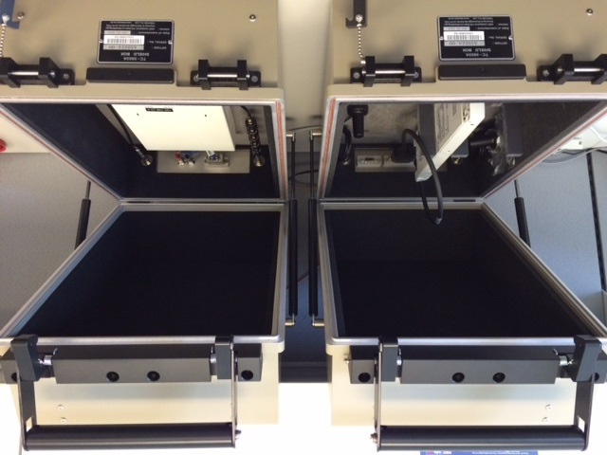
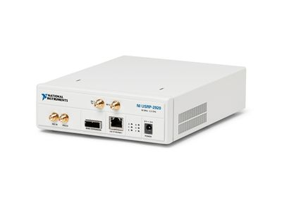
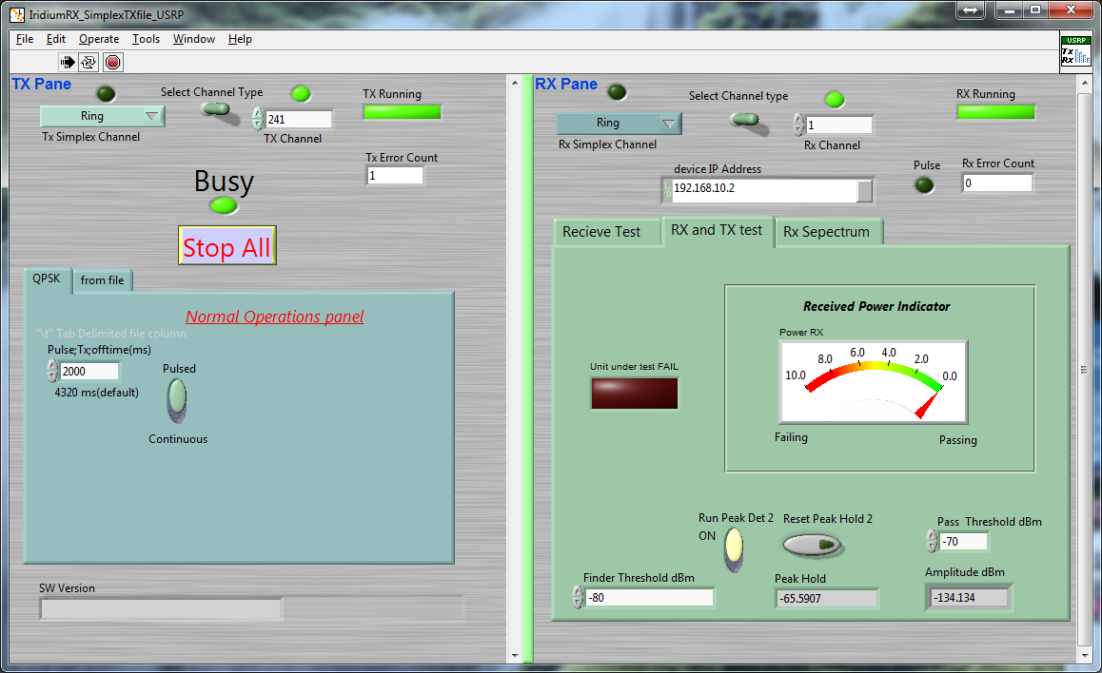
End of line/manufacturing test
Iridium has a suite of engineering tools intended for product development & testing
The End of Line test tool is one of the most commonly used
Allows partners to test products in a production/indoor environment
Requires USRP hardware that is supplied by National Instruments (approx. $2k)
Both radiated & conducted tests can be performed to allow testing of internal & external antennas
Testing is qualitative, not quantitative
Repeatability is good
A special command will place the device into test mode
The modem will look for a ring signal on a special channel (never see in the clear sky)
If the unique ring is decoded without bit errors then the modem transmits a full power burst back to the USRP allowing measurement of modems transmit power
If the received power is above the threshold, the software will display a pass

Slide 39
Questions
Average number of SBD sessions per day?
How many are MO & MT?
Average payload size?
Area (lat/long, sq miles) that modems are operating in?
Test/trial time periods? Phase 1/Phase 2?
Have we seen board/layout designs?

